Slide 1

Title: Data-Driven User Segmentation for TravelTide
Subtitle: Clustering and Analysis of User Travel Data
Presenter Name: Sushma Rai
Notes:
Hi, in this video, I’ll be walking you through a cluster analysis of travel data that we’ve conducted, including insights extracted from the dataset and a detailed explanation of the code used to achieve this. We will be discussing clusters of travelers based on flight and hotel booking behaviors.

Slide 2
As for the specific goals, Travel Tide has to shed light on consumers’ behavior to improve the loyalty programs.
Objective:
This is where user data must be leveraged to segment the customers next with a view to categorizing them based on their travel profiles and timely expenditure.
It will also be necessary to tie benefits to each customer segment in accordance with a customer-based value proposition.
Notes:
The goal is to analyze consumer behavior to enhance loyalty programs by segmenting customers based on travel profiles and expenditures, and tailoring benefits to each segment's needs.

Slide 3

Data Source
PostgreSQL database containing user, session, flight, and hotel booking data.
Query Overview:
Data fetched for users with more than 7 sessions.
Key fields include:
Demographics (birth year, gender, marital status)
Travel metrics (total sessions, total flights, total hotels)
Average flight fare, hotel costs
Flights and hotels booked
Notes:
Here's a summary of the query overview:
The PostgreSQL query retrieves data for users with more than seven sessions, including their demographics (birth year, gender, marital status) and travel metrics (total sessions, flights, and hotels). It also calculates the average flight fare and hotel costs, and lists the flights and hotels booked.

Slide 4
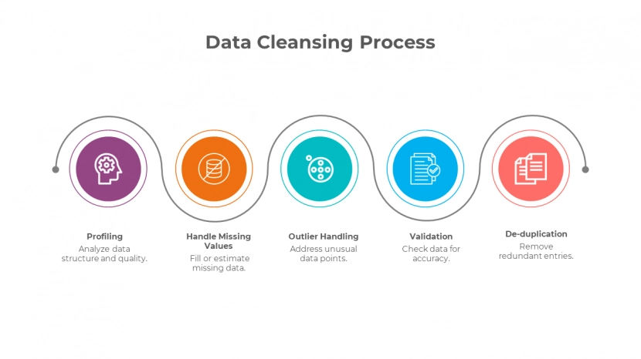
Data Processing & Cleaning
Handle missing values:
All the numeric columns are replaced with the mean values.
Columns with categorical distribution which is filled by the mode or ‘Unknown’.
Outlier Treatment:
Set a maximum on the average flight fare to the 95th percentile in order to eliminate gross outliers from its analysis.
Data Transformation:
The numeric columns are then casted to the right format that would be best suited for clustering.
Notes:
Missing values are addressed by replacing numeric columns with mean values and categorical columns with mode or 'Unknown'. Outliers are managed by capping the average flight fare at the 95th percentile, and numeric columns are formatted appropriately for clustering.

Slide 5
Feature Selection for Clustering
Key Features for Clustering:
Average flight fare, hotel costs, and session counts.
Total flights and hotels booked.
Feature Scaling:
Used the ‘StandardScaler’ to scale the data for clustering.
Notes:
Key features for clustering include average flight fare, hotel costs, session counts, and total flights and hotels booked. The data is scaled using 'StandardScaler' to ensure effective clustering.

Slide 6
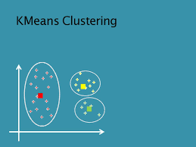
Clustering Approach
Methodology:
When clustering the customers according to travel behaviour, KMeans was applied.
Evaluation:
Concerning the number of clusters to be used, two techniques were applied namely Elbow Method and Silhouette Score
Optimal number of clusters chosen: 3.
Visualization:
Elbow Plot shows the reduction in inertia as cluster count increases.
Silhouette Plot helps evaluate how well-separated the clusters are.
Notes:
We applied KMeans clustering to segment customers based on their travel behavior.
To determine the optimal number of clusters, we used the Elbow Method and Silhouette Score, identifying 3 as the optimal number.
The Elbow Plot illustrates the decrease in inertia with more clusters, while the Silhouette Plot evaluates the distinctness of each cluster.

Slide 7
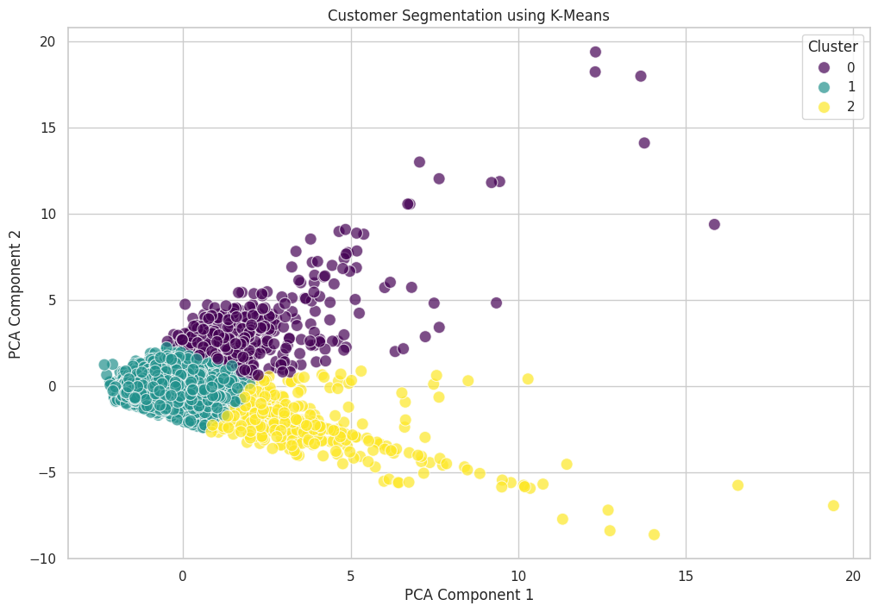
Principal Component Analysis (PCA)
Purpose of PCA:
Reduced data dimensionality to enhance the ability for visualizing the clusters of data.
PCA Visualization:
Two dimensional plot depicting customers in the principal component domain.
Notes:
We used PCA to reduce data dimensionality, which helps in visualizing clusters more clearly.
The two-dimensional plot shows customers positioned in the principal component space, making it easier to observe cluster patterns.

Slide 8
Cluster Analysis & Insights
Cluster Characteristics:
Determined the differences that exist between the clusters.
Summary of Clusters:
Cluster 0: This group seeks to maximize value, aligning with their focus on cost-efficiency.
Cluster 1: Provides convenience without significantly impacting their overall travel costs.
Cluster 2: High-end travelers who appreciate substantial perks that enhance their premium travel experience.
Notes:
We analyzed the distinct characteristics of each cluster to understand their unique travel behaviors.
Cluster 0 consists of value-conscious travelers who prioritize cost-efficiency and seek to maximize value.
Cluster 1 includes moderate spenders who prefer convenience without significantly increasing their travel expenses.
Cluster 2 represents luxury travelers who appreciate high-end perks that elevate their premium travel experiences.

Slide 9
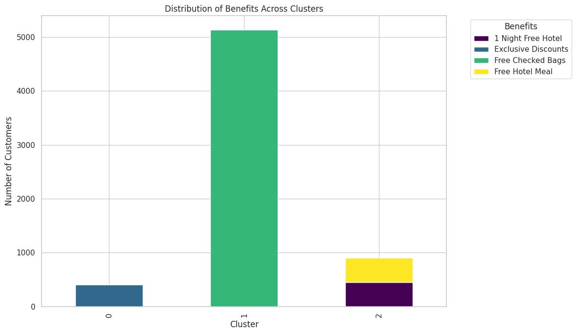
Benefit Mapping to Clusters
Loyalty Benefits Assigned to Clusters:
Tailored benefits such as free checked bags, free hotel meals, and exclusive discounts.
Benefit Distribution Plot:
Visualization showing the distribution of benefits across different cluster
Notes:
We tailored loyalty benefits for each cluster, offering perks like free checked bags, complimentary hotel meals, and exclusive discounts to enhance customer satisfaction and loyalty.
The visualization displays how these benefits are distributed among the different clusters, illustrating the allocation and impact of each benefit across the customer segments.

Slide 10
Results & Metrics
Key Results:
Clusters created based on spending and travel patterns.
Benefits mapped to customer segments to improve engagement.
Performance Metrics:
Silhouette Score: 0.48 (Moderate Separation)
Notes:
We created clusters based on spending and travel patterns and tailored benefits to these segments to boost engagement.
The Silhouette Score is 0.48, indicating moderate separation between clusters.

Slide 11
Conclusion
Successfully segmented TravelTide users into 3 clusters.
Personalized marketing strategies can be deployed based on cluster profiles.
Notes:
We successfully segmented TravelTide users into three distinct clusters based on their travel and spending patterns. Each cluster represents a unique customer profile with specific behaviors and preferences. Personalized marketing strategies can now be implemented tailored to these profiles to enhance engagement and drive loyalty. This targeted approach allows us to offer benefits and promotions that resonate with each cluster’s needs and preferences.

Slide 12
Recommendations
Incorporate Behavioral Data: Enhance clustering accuracy by integrating data on customer interactions and preferences.
Monitor and Adjust Models: Regularly review and update clustering models to adapt to evolving customer trends and market conditions.
Leverage Data for Personalization: Apply cluster-specific insights to create targeted marketing campaigns and personalized experiences.
Notes:
To enhance clustering accuracy, we should incorporate behavioral data on customer interactions and preferences. It’s crucial to regularly monitor and adjust our clustering models to keep pace with evolving customer trends and market conditions. Additionally, leveraging cluster-specific insights allows us to craft targeted marketing campaigns and deliver personalized experiences, ensuring greater engagement and satisfaction.

